Slide 1
Growing is fun !
Chaitra, Dayanand,
Kaalinga and Manasa

Slide 2
Customer / Problem Statement
Working Parents of nursery kids living in Tier 1 / 2 cities who want to provide a wide range of educational toys to their kids.

Slide 3
Pain Points
Price is an important concern for every parent while buying branded educational toys.
Hygiene, selection and time are a concern while renting toys online.
No easy way exists to rent educational toys.

Slide 4
Solution
A physical space (kid’s school) where parents can rent the toys of their kids choice.
SAVE
MONEY
SAVE
TIME
TRY
MANY

Slide 5
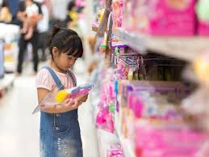
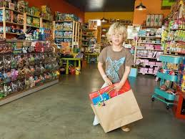
Product work flow
WALKIN TRY & SELECT RENT IT !!

Slide 6
Market Validation
Source: https://www.owler.com/
2009
2011
2009
1999
Online
Toys On Rent
Khilonewala
RenToys
Unnati Library
22.8 M
23.8 M
3.2 M
N/A
Physical
Party Toys/Play Zones
Low Registration Fee: 250 INR
Brand Awareness: 11,000 FB Followers
Delivery Issues
Corporate Tie Up
Hygiene Standards
Franchise Model: 45 Centers Across 35 Cities
Limited variety
7 Days Free Trial
Donate Toys After Use
Rent To Purchase Plan
Online Only
Variety of Subscription Plans
Large Inventory
4 Physical Stores in Bangalore
Cleanliness Concerns
Expensive
Affordable

Slide 7
Advantages and Differentiation
Try before renting
School as a channel
Educational Toys
3
1
2

Slide 8
Market Size in Bangalore (INR)
Source: Funskool Market research in 2017
Census Data 2011
1.57 B
(TAM)
472.5 M
(SAM)
0.44 M
(SOM)
Educational Rental Toys Market

Slide 9
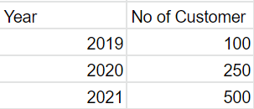
Revenue Model (INR)
Market Share Average subscription Total Revenue 2019-21
revenue/customer/year
3.74M
0.44 M
4400

Slide 10
Market Adoption
Events
Marketing
Marketing
Partnerships
Booths/Flyers
Traditional
Digital
Key Partners & Channels
Apartments Association Events
School Events
Birthday Parties
Word of Mouth Referrals
Ads/Billboards
SEO for landing page
Keyword Planner
Email
Facebook
Preschools
Daycare
Schools
Toy Industries

Slide 11
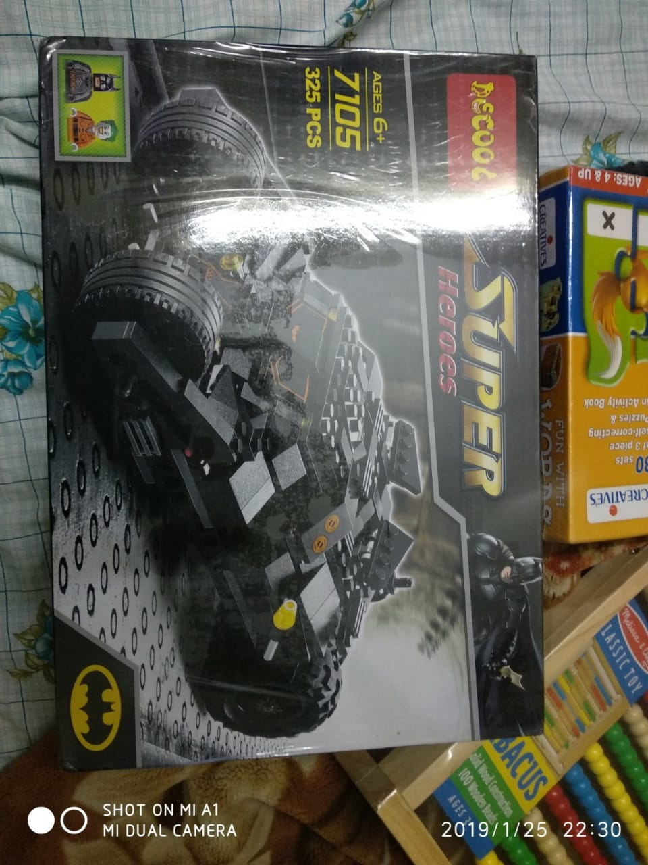
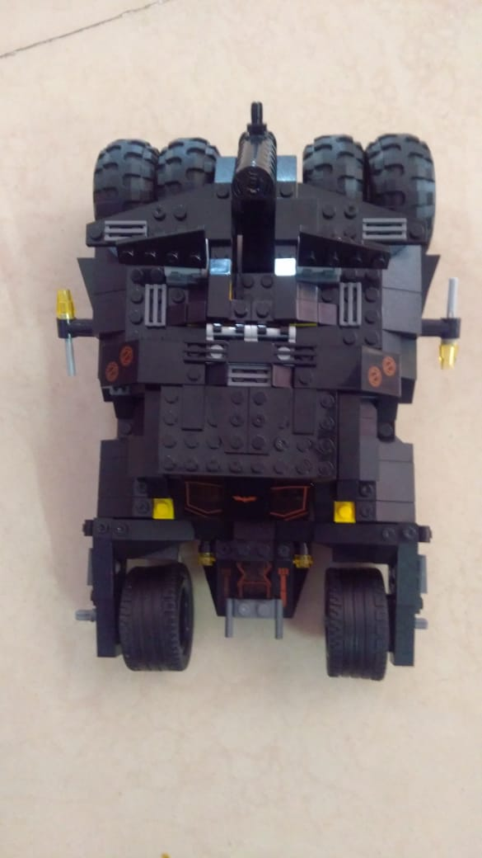
Solution Validation (Trial plan)
Toy Rented
(Feb 21st - Mar 7th)
First Payment !!
Fun & Learn

Slide 12
Explainer Video

Slide 13
Appendix
https://www.edutoysrental.com/
https://www.facebook.com/EduToys-Rental-510649552675760/
https://shoutout.wix.com/so/68MbTa_6l#/main

Slide 14
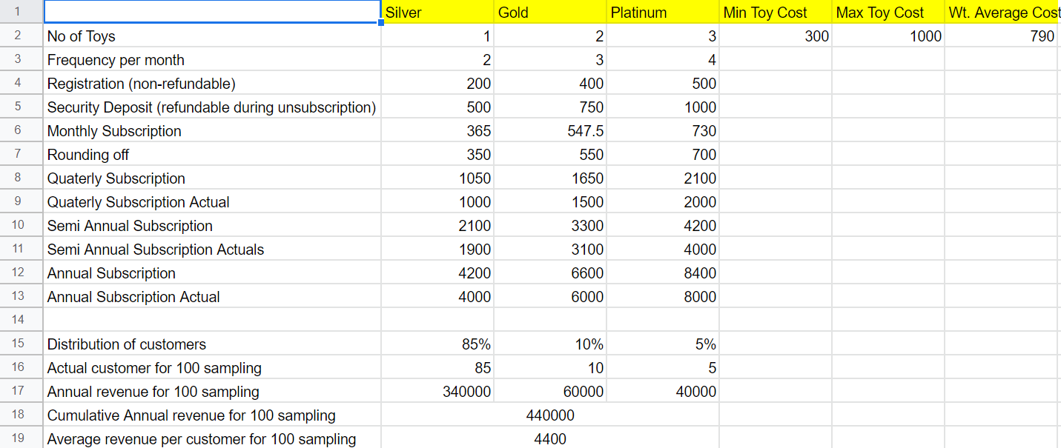
Pricing - Margin based

Slide 15
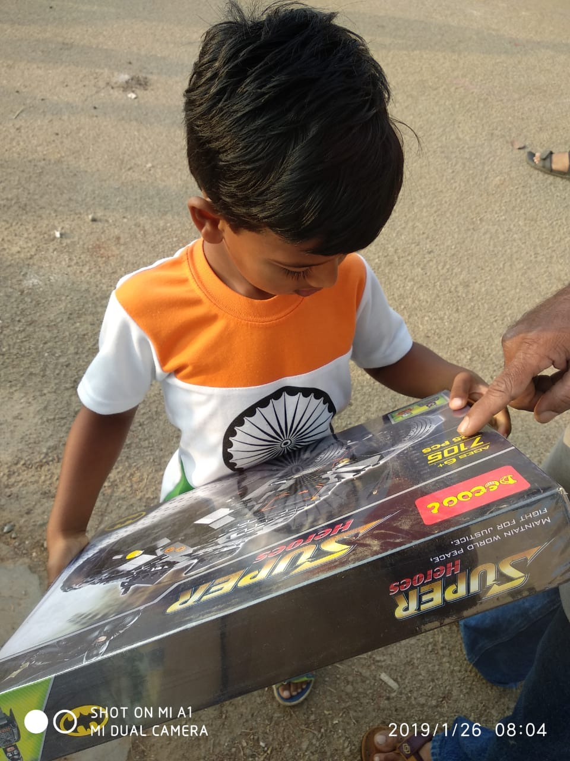
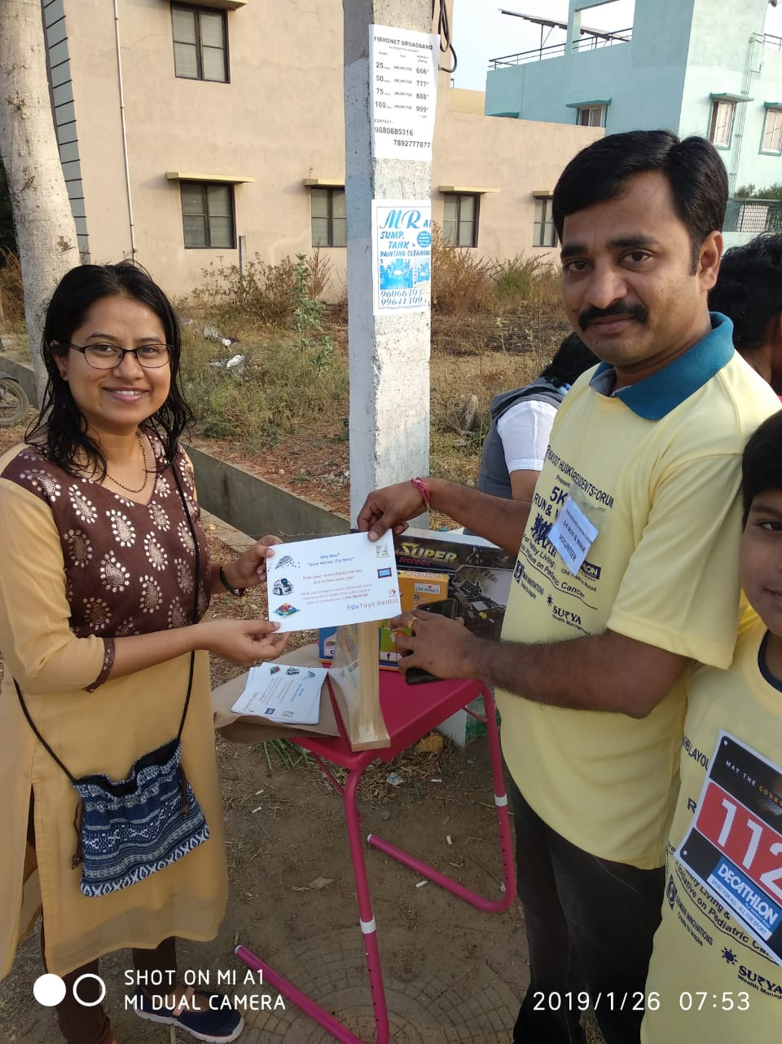
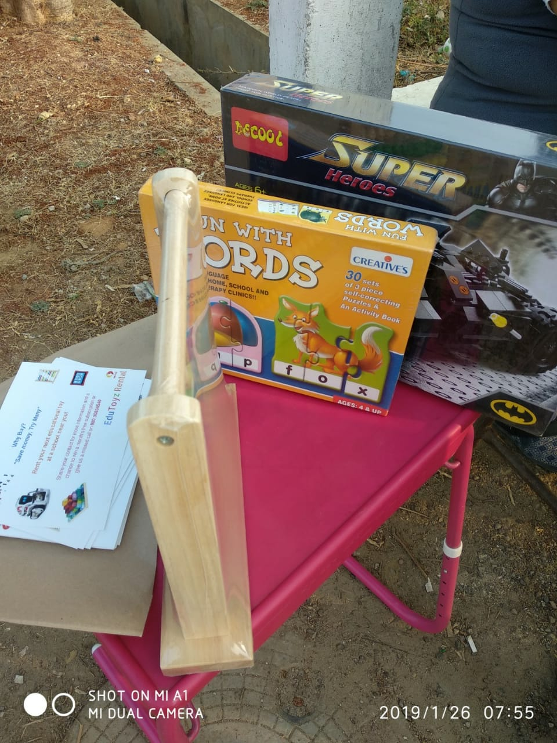
Awareness Events Photos

Slide 16
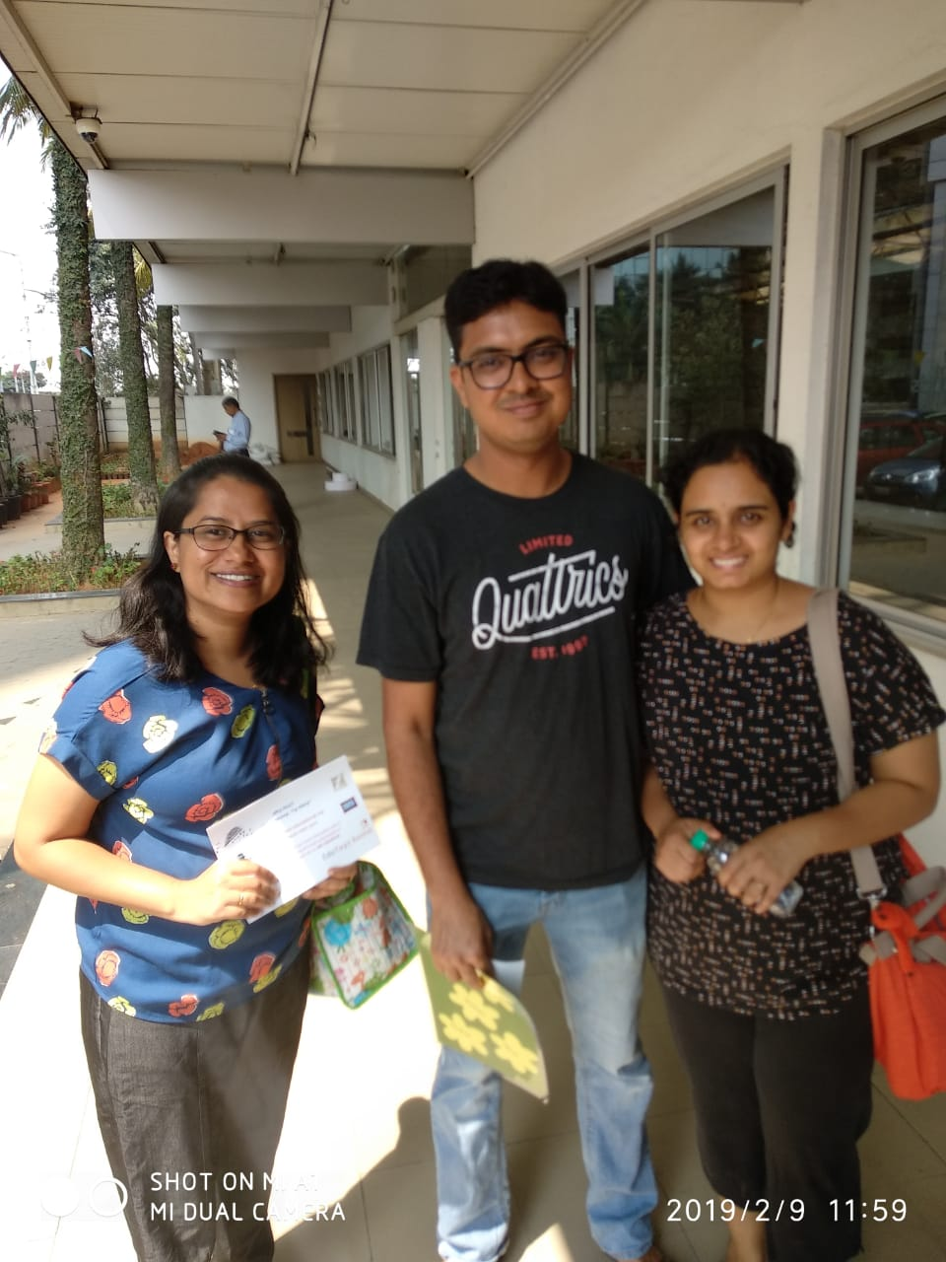
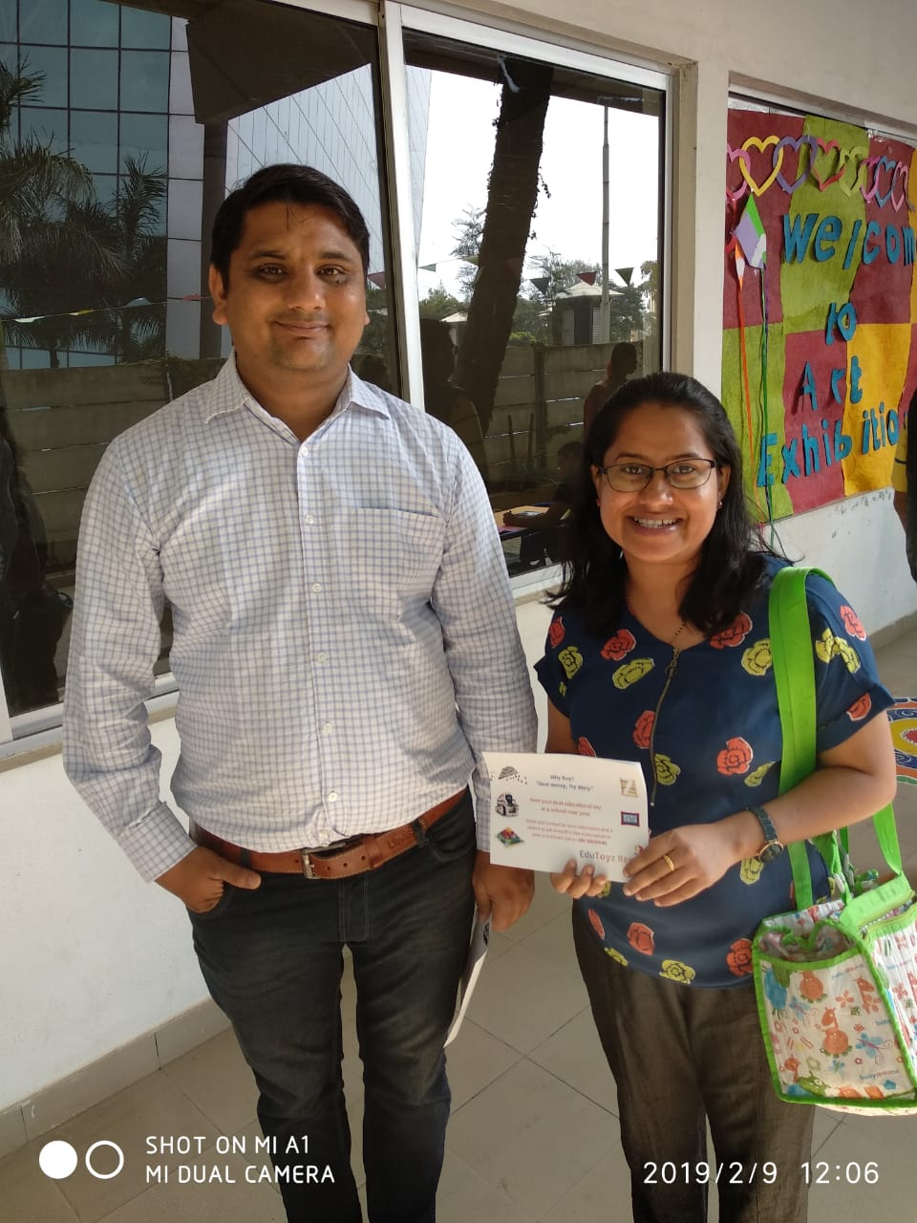
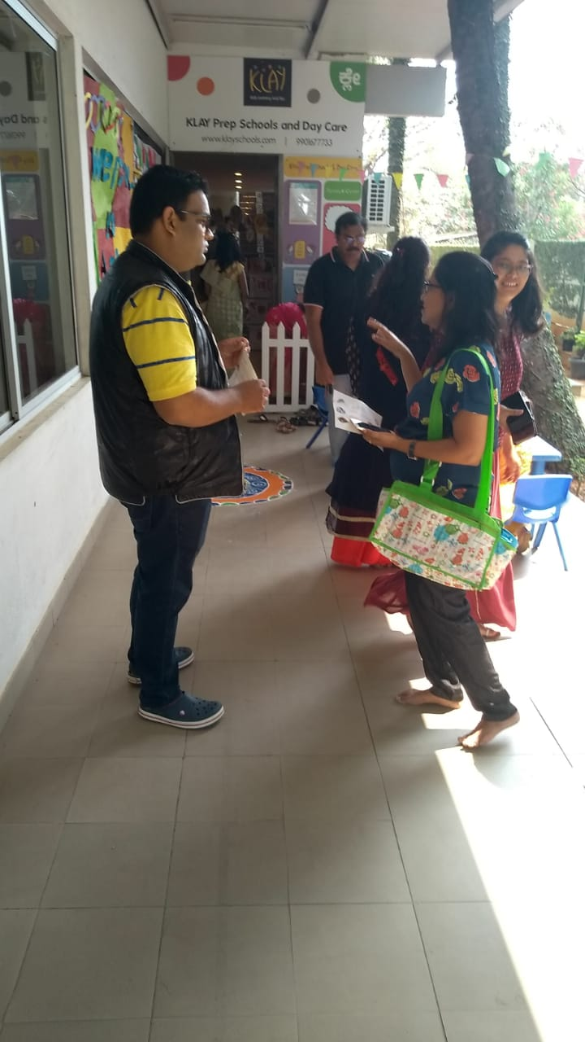
Lead Generation photos

Slide 17
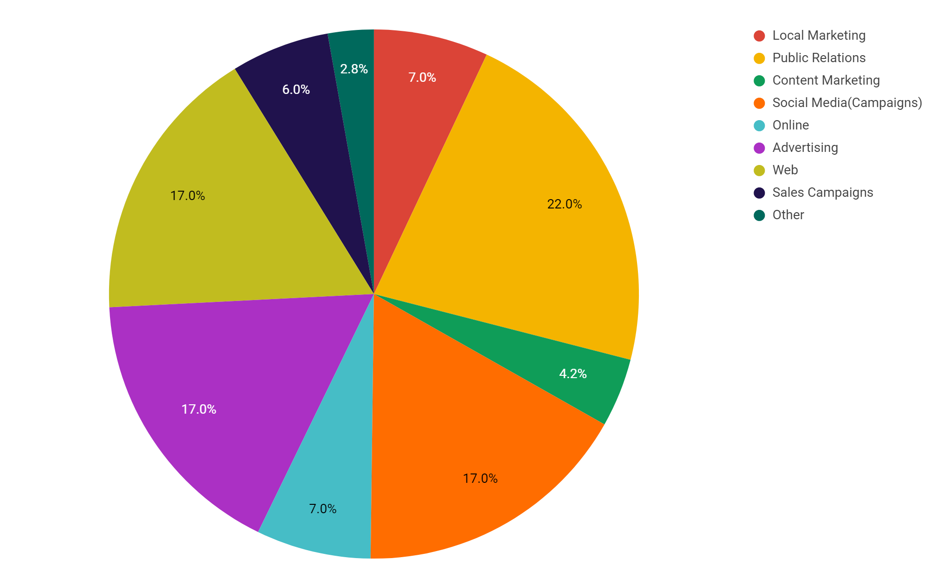
Marketing Budget Plan
Marketing Budget: | 22,000.00 INR

Slide 18
Positioning Statement
For parents of nursery kids
Who want to provide fun based learning to their kids
The EduToysRental is an physical platform
That helps parents/kids to choose educational toys on rent
Unlike Rentoys, Khilonewala, ToysOnRent, Unnati Library
EduToysRental have their physical spaces in school for easy access and tangible experience for quality check.

Slide 19
Awareness and Lead Generation
Klay School Art Exhibition Events
Landing Page
Facebook Campaigns
Missed calls
Flyers
Jan 2019
March 2019
Dec 2018
Feb 2019
Apartment Association events
Landing Page
Word of Mouth referrals by Customers
Email Campaigns
Landing Page

Slide 20
Lead generation count
2
14
16
3
Missed call
Events
Social Media
Landing Page
Source: OneRing
Source: Apartment Association,
Kaly art exhibition
Source: Facebook
Source: https://edutoysrental.com

Slide 21
Billboards

Slide 22
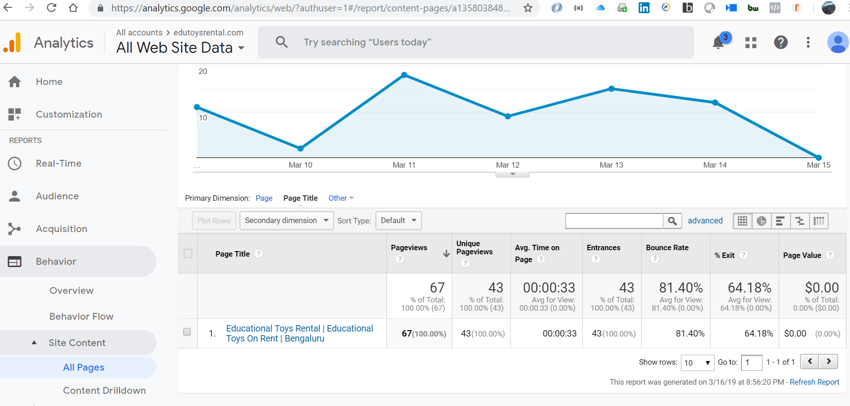
Google Analytics

Slide 23
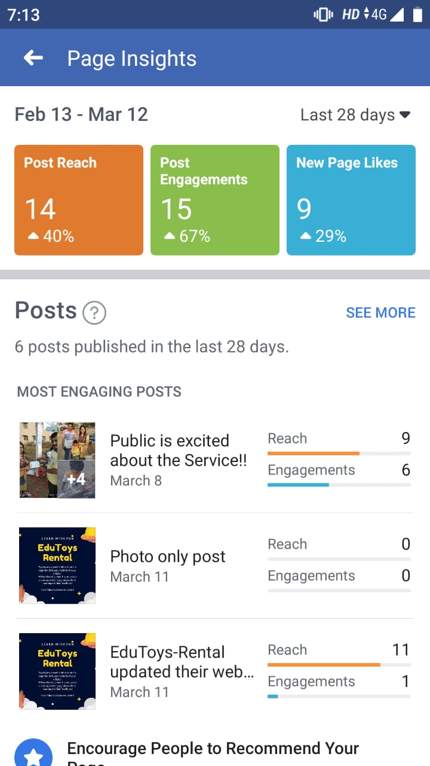
Facebook page insights

Slide 24
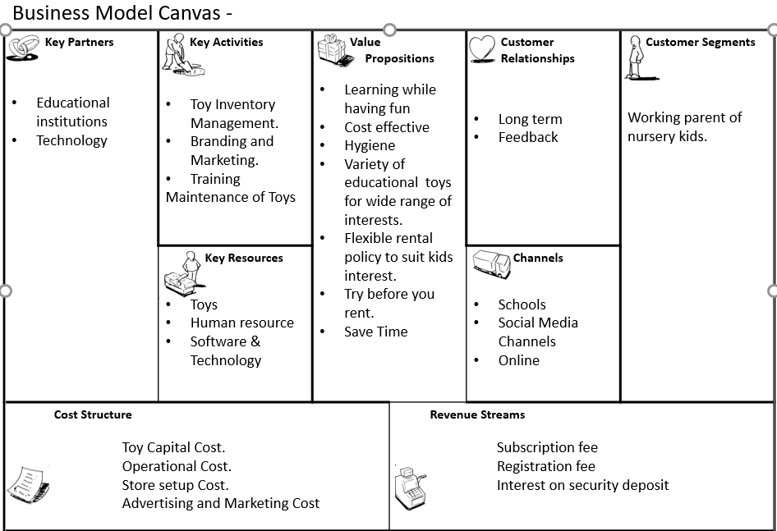

Slide 25
Elements of Value
Try before renting
VR Driven Demos
Toy suggestions based on kid’s interest using AI
Hygiene
Toys
Easy and variety of educational toys rental service
Age appropriate toys
Customer Services
Branded Education toys
Mobile App
Physical space in schools
Cognitive catalog
Subscription
based
Toy exploration service

Slide 26
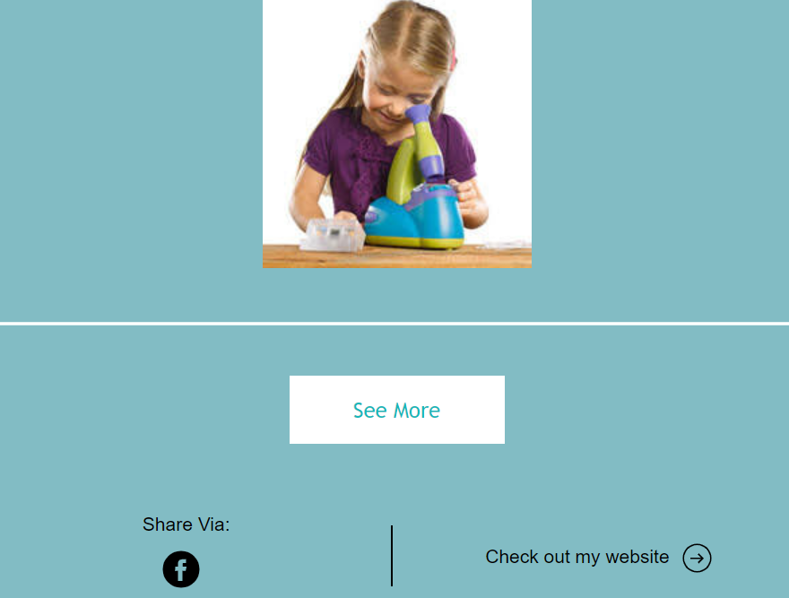
Email Campaign

Slide 27
Next Steps
Channel Validation
Pricing Models
Research Educational toys brand
Marketing

Slide 28
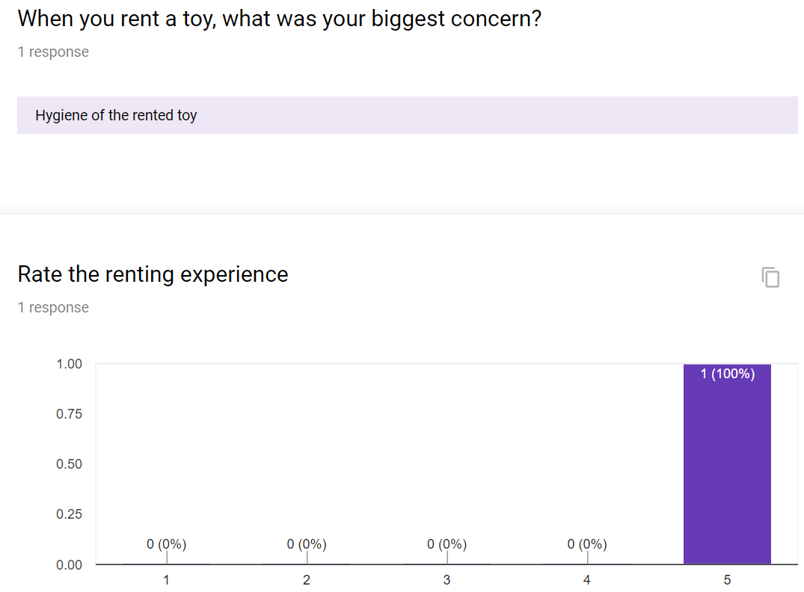
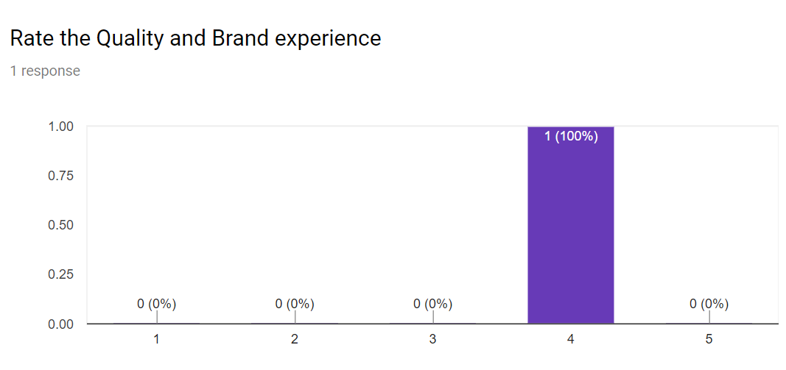
Customer Feedback Survey

Slide 29
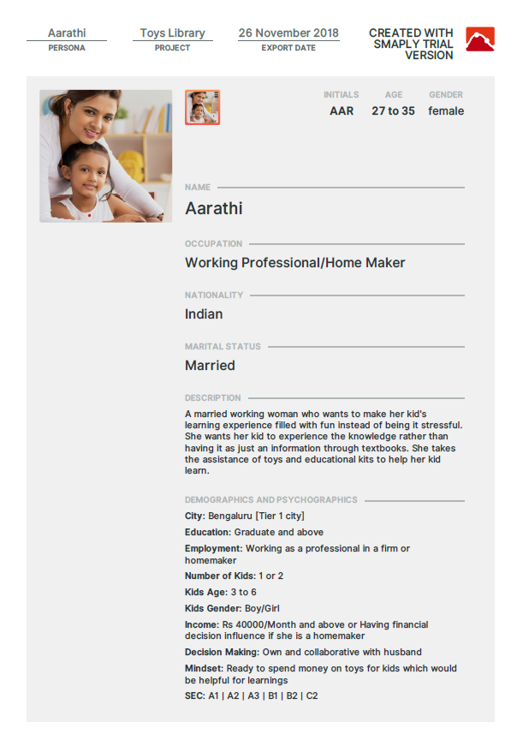
Persona

Slide 30
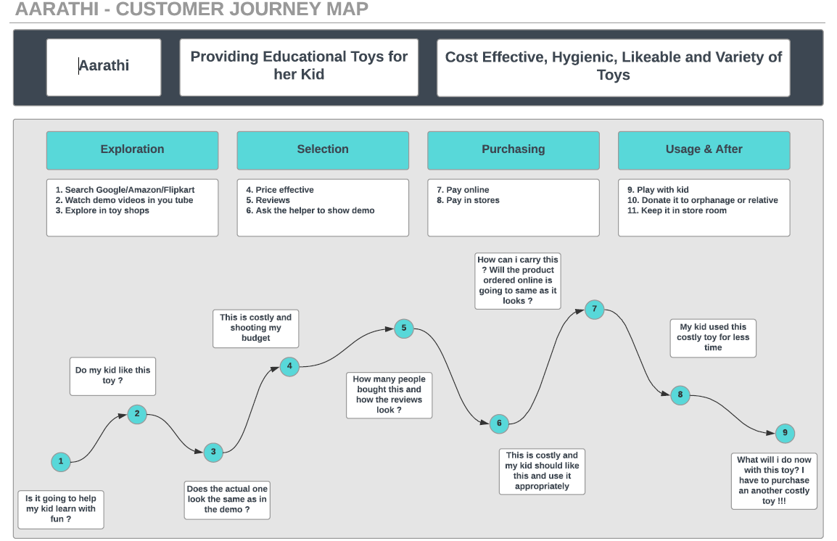
Customer journey Map

Slide 31
Competitive Analysis
Direct
RenToys
ToysonRent
Khilonewala
Unnati Library
Indirect
Flintobox
Toys Purchase

